Slide 1
Chapter 6
Storage and Other I/O Topics
Notes:
Morgan Kaufmann Publishers
Chapter 6 — Storage and Other I/O Topics

Slide 2
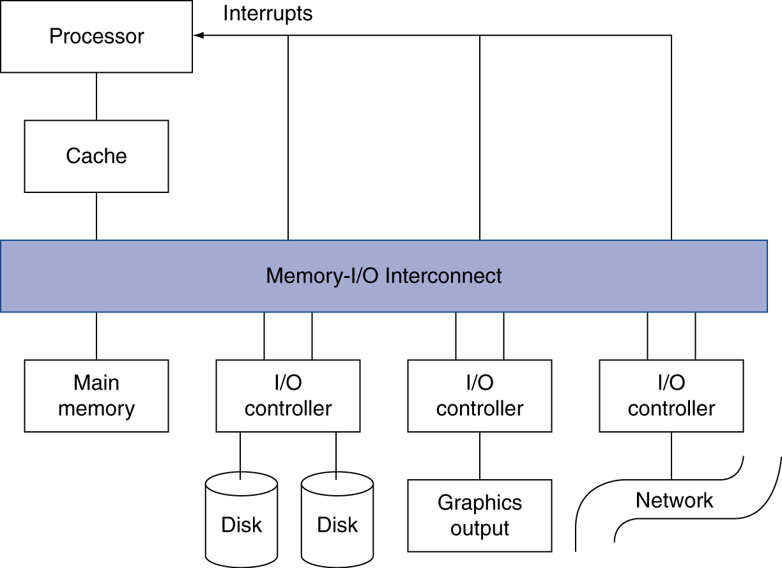
Introduction
§6.1 Introduction
I/O devices can be characterized by
  Behaviour: input, output, storage
  Partner: human or machine
  Data rate: bytes/sec, transfers/sec
I/O bus connections
Chapter 6 — Storage and Other I/O Topics — <number>
Notes:
Morgan Kaufmann Publishers
Chapter 6 — Storage and Other I/O Topics

Slide 3
I/O System Characteristics
Dependability is important
  Particularly for storage devices
Performance measures
  Latency (response time)
  Throughput (bandwidth)
  Desktops & embedded systems
    Mainly interested in response time & diversity of devices
  Servers
    Mainly interested in throughput & expandability of devices
Chapter 6 — Storage and Other I/O Topics — <number>
Notes:
Morgan Kaufmann Publishers
Chapter 6 — Storage and Other I/O Topics

Slide 4
Disk Performance Issues
Manufacturers quote average seek time
  Based on all possible seeks
  Locality and OS scheduling lead to smaller actual average seek times
Smart disk controller allocate physical sectors on disk
  Present logical sector interface to host
  SCSI, ATA, SATA
Disk drives include caches
  Prefetch sectors in anticipation of access
  Avoid seek and rotational delay
Chapter 6 — Storage and Other I/O Topics — <number>
Notes:
Morgan Kaufmann Publishers
Chapter 6 — Storage and Other I/O Topics

Slide 5
Interconnecting Components
Need interconnections between
  CPU, memory, I/O controllers
Bus: shared communication channel
  Parallel set of wires for data and synchronization of data transfer
  Can become a bottleneck
Performance limited by physical factors
  Wire length, number of connections
More recent alternative: high-speed serial connections with switches
  Like networks
§6.5 Connecting Processors, Memory, and I/O Devices
Chapter 6 — Storage and Other I/O Topics — <number>
Notes:
Morgan Kaufmann Publishers
Chapter 6 — Storage and Other I/O Topics

Slide 6
Bus Types
Processor-Memory buses
  Short, high speed
  Design is matched to memory organization
I/O buses
  Longer, allowing multiple connections
  Specified by standards for interoperability
  Connect to processor-memory bus through a bridge
Chapter 6 — Storage and Other I/O Topics — <number>
Notes:
Morgan Kaufmann Publishers
Chapter 6 — Storage and Other I/O Topics

Slide 7
Bus Signals and Synchronization
Data lines
  Carry address and data
  Multiplexed or separate
Control lines
  Indicate data type, synchronize transactions
Synchronous
  Uses a bus clock
Asynchronous
  Uses request/acknowledge control lines for handshaking
Chapter 6 — Storage and Other I/O Topics — <number>
Notes:
Morgan Kaufmann Publishers
Chapter 6 — Storage and Other I/O Topics

Slide 8
I/O Bus Examples
 | Firewire | USB 2.0 | PCI Express | Serial ATA | Serial Attached SCSI
Intended use | External | External | Internal | Internal | External
Devices per channel | 63 | 127 | 1 | 1 | 4
Data width | 4 | 2 | 2/lane | 4 | 4
Peak bandwidth | 50MB/s or 100MB/s | 0.2MB/s, 1.5MB/s, or 60MB/s | 250MB/s/lane 1×, 2×, 4×, 8×, 16×, 32× | 300MB/s | 300MB/s
Hot pluggable | Yes | Yes | Depends | Yes | Yes
Max length | 4.5m | 5m | 0.5m | 1m | 8m
Standard | IEEE 1394 | USB Implementers Forum | PCI-SIG | SATA-IO | INCITS TC T10
Chapter 6 — Storage and Other I/O Topics — <number>
Notes:
Morgan Kaufmann Publishers
Chapter 6 — Storage and Other I/O Topics

Slide 9
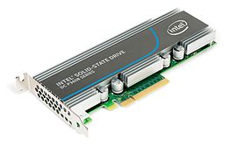
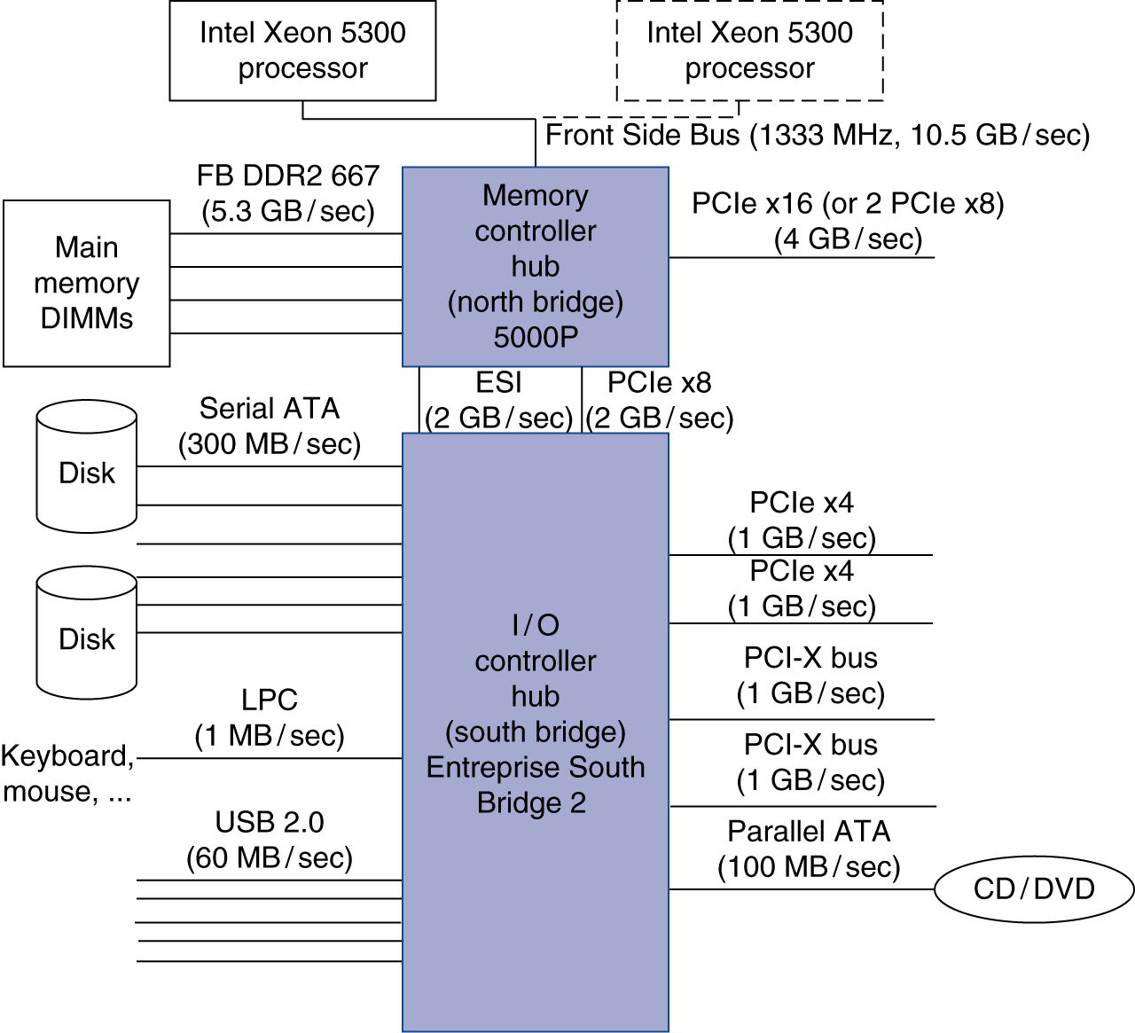
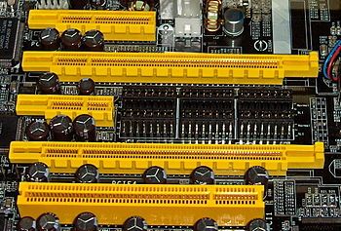
Typical x86 PC I/O System
Chapter 6 — Storage and Other I/O Topics — <number>
Notes:
Morgan Kaufmann Publishers
Chapter 6 — Storage and Other I/O Topics

Slide 10
I/O Management
I/O is mediated by the OS
  Multiple programs share I/O resources
    Need protection and scheduling
  I/O causes asynchronous interrupts
    Same mechanism as exceptions
  I/O programming is fiddly
    OS provides abstractions to programs
§6.6 Interfacing I/O Devices …
Chapter 6 — Storage and Other I/O Topics — <number>
Notes:
Morgan Kaufmann Publishers
Chapter 6 — Storage and Other I/O Topics

Slide 11
I/O Commands
I/O devices are managed by I/O controller hardware
  Transfers data to/from device
  Synchronizes operations with software
Command registers
  Cause device to do something
Status registers
  Indicate what the device is doing and occurrence of errors
Data registers
  Write: transfer data to a device
  Read: transfer data from a device
Chapter 6 — Storage and Other I/O Topics — <number>
Notes:
Morgan Kaufmann Publishers
Chapter 6 — Storage and Other I/O Topics

Slide 12
I/O Register Mapping
Memory mapped I/O
  Registers are addressed in same space as memory
  Address decoder distinguishes between them
  OS uses address translation mechanism to make them only accessible to kernel
I/O instructions
  Separate instructions to access I/O registers
  Can only be executed in kernel mode
  Example: x86
Chapter 6 — Storage and Other I/O Topics — <number>
Notes:
Morgan Kaufmann Publishers
Chapter 6 — Storage and Other I/O Topics

Slide 13
Polling
Periodically check I/O status register
  If device ready, do operation
  If error, take action
Common in small or low-performance real-time embedded systems
  Predictable timing
  Low hardware cost
In other systems, wastes CPU time
Chapter 6 — Storage and Other I/O Topics — <number>
Notes:
Morgan Kaufmann Publishers
Chapter 6 — Storage and Other I/O Topics

Slide 14
Interrupts
When a device is ready or error occurs
  Controller interrupts CPU
Interrupt is like an exception
  But not synchronized to instruction execution
  Can invoke handler between instructions
  Cause information often identifies the interrupting device
Priority interrupts
  Devices needing more urgent attention get higher priority
  Can interrupt handler for a lower priority interrupt
Chapter 6 — Storage and Other I/O Topics — <number>
Notes:
Morgan Kaufmann Publishers
Chapter 6 — Storage and Other I/O Topics

Slide 15
I/O Data Transfer
Polling and interrupt-driven I/O
  CPU transfers data between memory and I/O data registers
  Time consuming for high-speed devices
Direct memory access (DMA)
  OS provides starting address in memory
  I/O controller transfers to/from memory autonomously
  Controller interrupts on completion or error
Chapter 6 — Storage and Other I/O Topics — <number>
Notes:
Morgan Kaufmann Publishers
Chapter 6 — Storage and Other I/O Topics

Slide 16
DMA/Cache Interaction
If DMA writes to a memory block that is cached
  Cached copy becomes stale
If write-back cache has dirty block, and DMA reads memory block
  Reads stale data
Need to ensure cache coherence
  Flush blocks from cache if they will be used for DMA
  Or use non-cacheable memory locations for I/O
Chapter 6 — Storage and Other I/O Topics — <number>
Notes:
Morgan Kaufmann Publishers
Chapter 6 — Storage and Other I/O Topics

Slide 17
RAID
Redundant Array of Inexpensive (Independent) Disks
  Use multiple smaller disks (c.f. one large disk)
  Parallelism improves performance
  Plus extra disk(s) for redundant data storage
Provides fault tolerant storage system
  Especially if failed disks can be “hot swapped”
RAID 0
  No redundancy (“AID”?)
    Just stripe data over multiple disks
  But it does improve performance
Chapter 6 — Storage and Other I/O Topics — <number>
Notes:
Morgan Kaufmann Publishers
Chapter 6 — Storage and Other I/O Topics

Slide 18
RAID 1 & 2
RAID 1: Mirroring
  N + N disks, replicate data
    Write data to both data disk and mirror disk
    On disk failure, read from mirror
RAID 2: Error correcting code (ECC)
  N + E disks (e.g., 10 + 4)
  Split data at bit level across N disks
  Generate E-bit ECC
  Too complex, not used in practice
Chapter 6 — Storage and Other I/O Topics — <number>
Notes:
Morgan Kaufmann Publishers
Chapter 6 — Storage and Other I/O Topics

Slide 19
RAID 3: Bit-Interleaved Parity
N + 1 disks
  Data striped across N disks at byte level
  Redundant disk stores parity
  Read access
    Read all disks
  Write access
    Generate new parity and update all disks
  On failure
    Use parity to reconstruct missing data
Not widely used
Chapter 6 — Storage and Other I/O Topics — <number>
Notes:
Morgan Kaufmann Publishers
Chapter 6 — Storage and Other I/O Topics

Slide 20
RAID 4: Block-Interleaved Parity
N + 1 disks
  Data striped across N disks at block level
  Redundant disk stores parity for a group of blocks
  Read access
    Read only the disk holding the required block
  Write access
    Just read disk containing modified block, and parity disk
    Calculate new parity, update data disk and parity disk
  On failure
    Use parity to reconstruct missing data
Not widely used
Chapter 6 — Storage and Other I/O Topics — <number>
Notes:
Morgan Kaufmann Publishers
Chapter 6 — Storage and Other I/O Topics

Slide 21
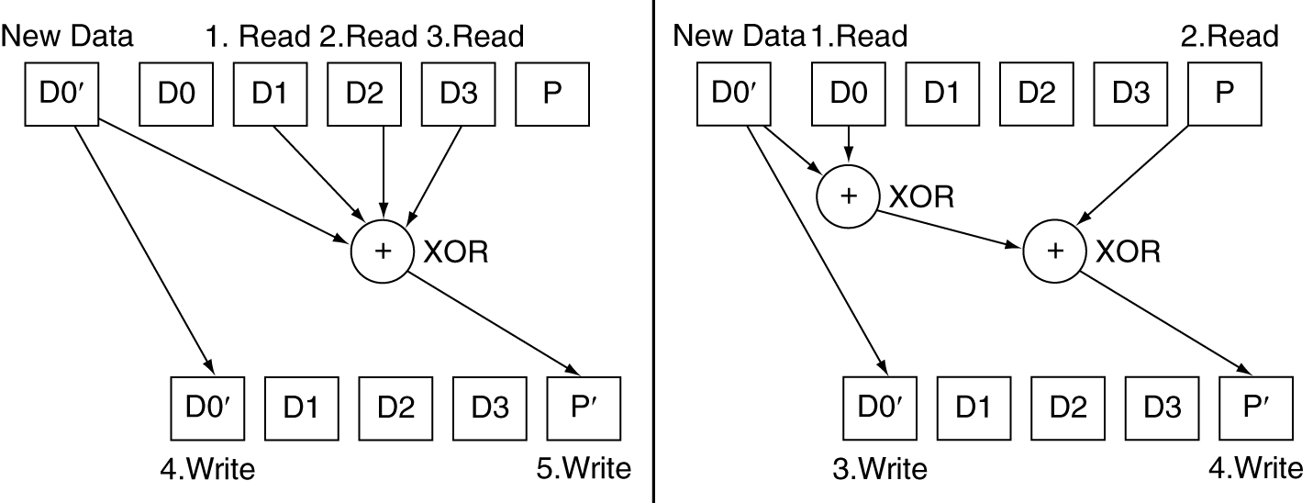
RAID 3 vs RAID 4
Chapter 6 — Storage and Other I/O Topics — <number>
Notes:
Morgan Kaufmann Publishers
Chapter 6 — Storage and Other I/O Topics

Slide 22
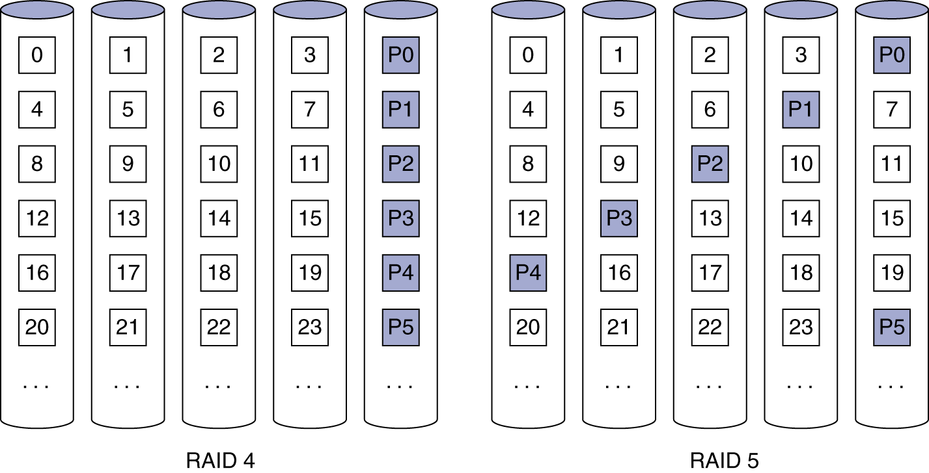
RAID 5: Distributed Parity
N + 1 disks
  Like RAID 4, but parity blocks distributed across disks
    Avoids parity disk being a bottleneck
Widely used
Chapter 6 — Storage and Other I/O Topics — <number>
Notes:
Morgan Kaufmann Publishers
Chapter 6 — Storage and Other I/O Topics

Slide 23
RAID 6: P + Q Redundancy
N + 2 disks
  Like RAID 5, but two lots of parity
  Greater fault tolerance through more redundancy
Multiple RAID
  More advanced systems give similar fault tolerance with better performance
Chapter 6 — Storage and Other I/O Topics — <number>
Notes:
Morgan Kaufmann Publishers
Chapter 6 — Storage and Other I/O Topics

Slide 24
RAID Summary
RAID can improve performance and availability
  High availability requires hot swapping
Assumes independent disk failures
  Too bad if the building burns down!
See “Hard Disk Performance, Quality and Reliability”
  http://www.pcguide.com/ref/hdd/perf/index.htm
Chapter 6 — Storage and Other I/O Topics — <number>
Notes:
Morgan Kaufmann Publishers
Chapter 6 — Storage and Other I/O Topics

Slide 25
I/O System Design
Satisfying latency requirements
  For time-critical operations
  If system is unloaded
    Add up latency of components
Maximizing throughput
  Find “weakest link” (lowest-bandwidth component)
  Configure to operate at its maximum bandwidth
  Balance remaining components in the system
If system is loaded, simple analysis is insufficient
  Need to use queuing models or simulation
§6.8 Designing and I/O System
Chapter 6 — Storage and Other I/O Topics — <number>
Notes:
Morgan Kaufmann Publishers
Chapter 6 — Storage and Other I/O Topics

Slide 26
Server Computers
Applications are increasingly run on servers
  Web search, office apps, virtual worlds, …
Requires large data center servers
  Multiple processors, networks connections, massive storage
  Space and power constraints
Server equipment built for 19” racks
  Multiples of 1.75” (1U) high
§6.10 Real Stuff: Sun Fire x4150 Server
Chapter 6 — Storage and Other I/O Topics — <number>
Notes:
Morgan Kaufmann Publishers
Chapter 6 — Storage and Other I/O Topics

Slide 27
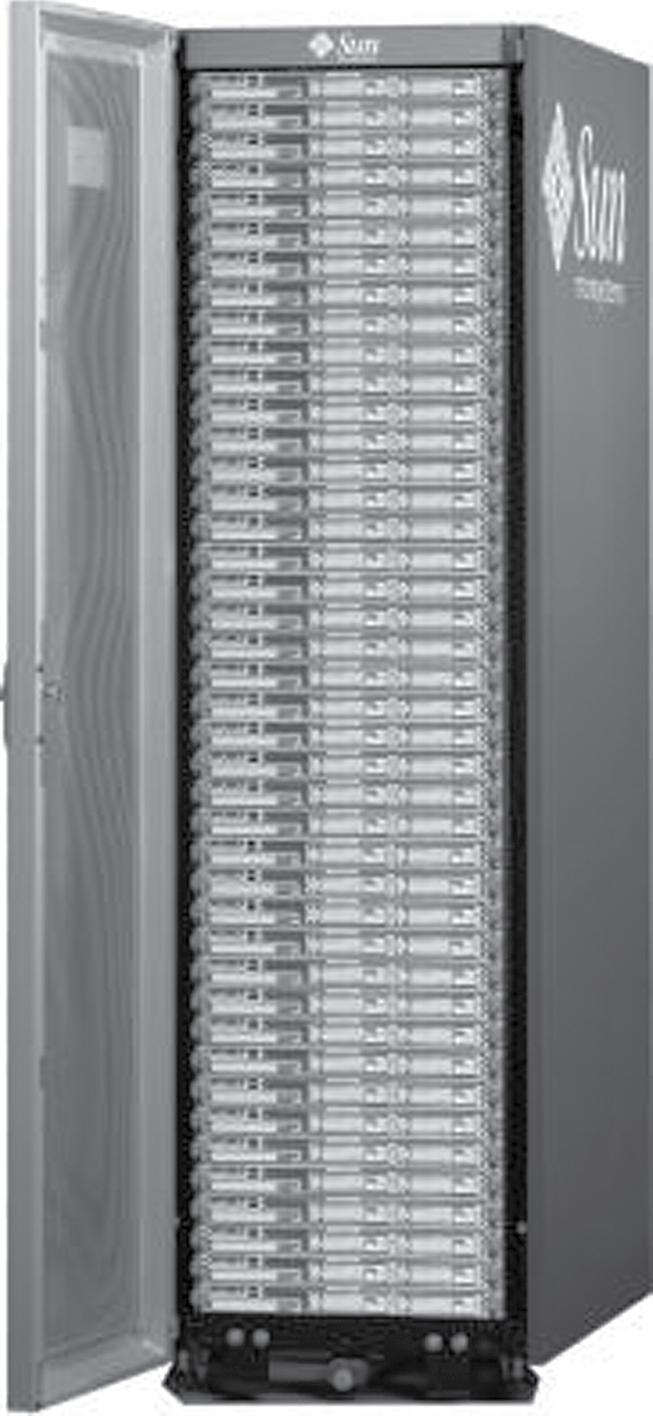
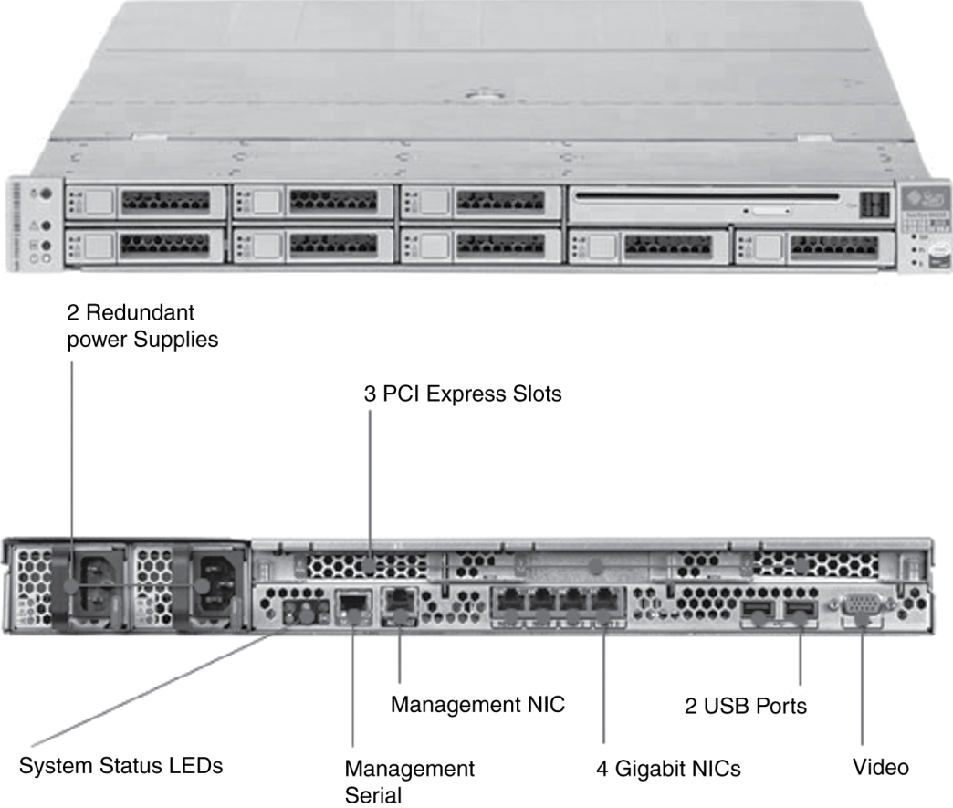
Rack-Mounted Servers
Sun Fire x4150 1U server
Chapter 6 — Storage and Other I/O Topics — <number>
Notes:
Morgan Kaufmann Publishers
Chapter 6 — Storage and Other I/O Topics

Slide 28
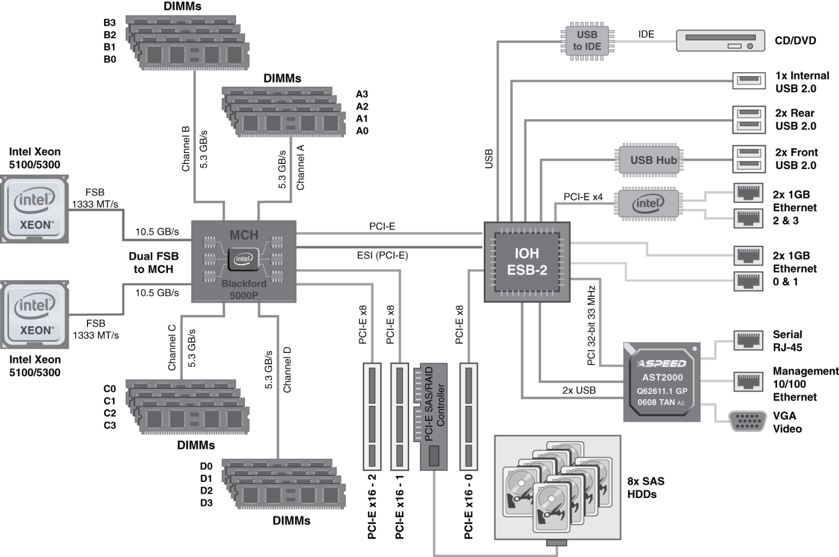
Sun Fire x4150 1U server
4 cores each
16 x 4GB = 64GB DRAM
Chapter 6 — Storage and Other I/O Topics — <number>
Notes:
Morgan Kaufmann Publishers
Chapter 6 — Storage and Other I/O Topics

Slide 29
I/O System Design Example
Given a Sun Fire x4150 system with
  Workload: 64KB disk reads
    Each I/O op requires 200,000 user-code instructions and 100,000 OS instructions
  Each CPU: 10⁹ instructions/sec
  FSB: 10.6 GB/sec peak
  DRAM DDR2 667MHz: 5.336 GB/sec
  PCI-E 8× bus: 8 × 250MB/sec = 2GB/sec
  Disks: 15,000 rpm, 2.9ms avg. seek time, 112MB/sec transfer rate
What I/O rate can be sustained?
  For random reads, and for sequential reads
Chapter 6 — Storage and Other I/O Topics — <number>
Notes:
Morgan Kaufmann Publishers
Chapter 6 — Storage and Other I/O Topics

Slide 30
Design Example (cont)
I/O rate for CPUs
  Per core: 10⁹/(100,000 + 200,000) = 3,333
  8 cores: 26,667 ops/sec
Random reads, I/O rate for disks
  Assume actual seek time is average/4
  Time/op = seek + latency + transfer
  = 2.9ms/4 + 4ms/2 + 64KB/(112MB/s) = 3.3ms
  303 ops/sec per disk, 2424 ops/sec for 8 disks
Sequential reads
  112MB/s / 64KB = 1750 ops/sec per disk
  14,000 ops/sec for 8 disks
Chapter 6 — Storage and Other I/O Topics — <number>
Notes:
Morgan Kaufmann Publishers
Chapter 6 — Storage and Other I/O Topics

Slide 31
Design Example (cont)
PCI-E I/O rate
  2GB/sec / 64KB = 31,250 ops/sec
DRAM I/O rate
  5.336 GB/sec / 64KB = 83,375 ops/sec
FSB I/O rate
  Assume we can sustain half the peak rate
  5.3 GB/sec / 64KB = 81,540 ops/sec per FSB
  163,080 ops/sec for 2 FSBs
Weakest link: disks
  2424 ops/sec random, 14,000 ops/sec sequential
  Other components have ample headroom to accommodate these rates
Chapter 6 — Storage and Other I/O Topics — <number>
Notes:
Morgan Kaufmann Publishers
Chapter 6 — Storage and Other I/O Topics

